Slide 1
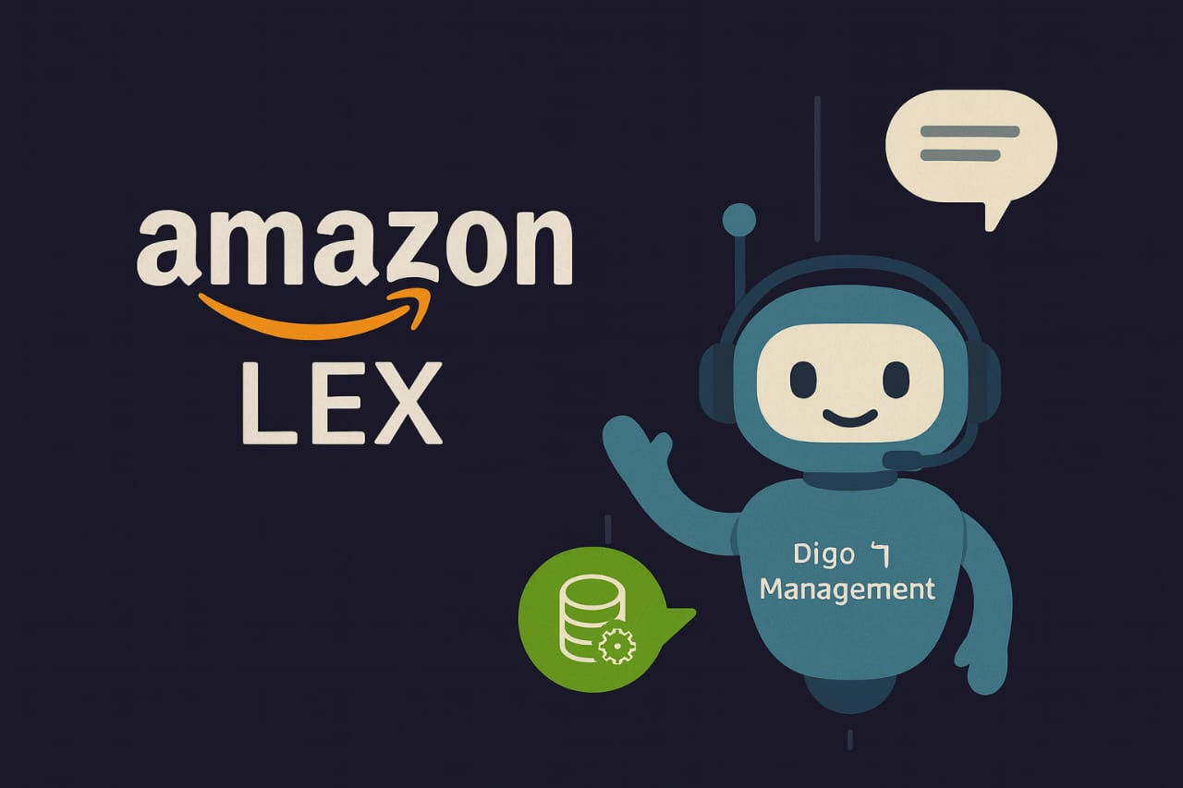
MINI PROJECT
By subashini
SEPTEMBER BATCH

Slide 2
Definition:
Conversational AI refers to systems that can understand and respond to human language (spoken or written) in a way that feels natural, like you're talking to a human. It combines Natural Language Understanding (NLU), dialogue management, and sometimes Automatic Speech Recognition (ASR).Use Cases: Customer support chatbots, voice assistants, virtual agents, IVR systems, and more.

Slide 3
Key Capabilities:
Intent Recognition: Detecting what the user wants (e.g., “book appointment”, “check order status”).
Slot Filling: Extracting parameters (e.g., date, time, name) from the user’s input.
Context Handling / Multi-turn Dialogs: Maintaining context across multiple messages.Fulfillment: Executing business logic (you might call an API, or trigger a backend task).
Fulfillment: Executing business logic (you might call an API, or trigger a backend task).

Slide 4
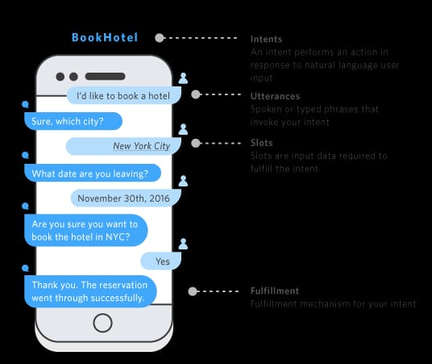

Slide 5
4. Design & DeploymentVisual Conversation Builder: A drag-and-drop interface to design conversation flows. Automated Chatbot Designer: If you have transcripts (e.g., from past customer chats), Lex can analyze them to suggest intents and design. Versioning: Lex supports versions and aliases (like “dev”, “prod”) for lifecycle management. Multi-platform Deployment: Once built, bots can be deployed to web apps, mobile apps, Facebook Messenger, Slack, Twilio SMS, and more.

Slide 6
5. Monitoring & AnalyticsLex provides dashboards and metrics (e.g., intent recognition rate) so you can monitor bot performance.
6. Cost ModelYou pay for what you use: there is no upfront cost, and you are billed per request (text or speech).

Slide 7
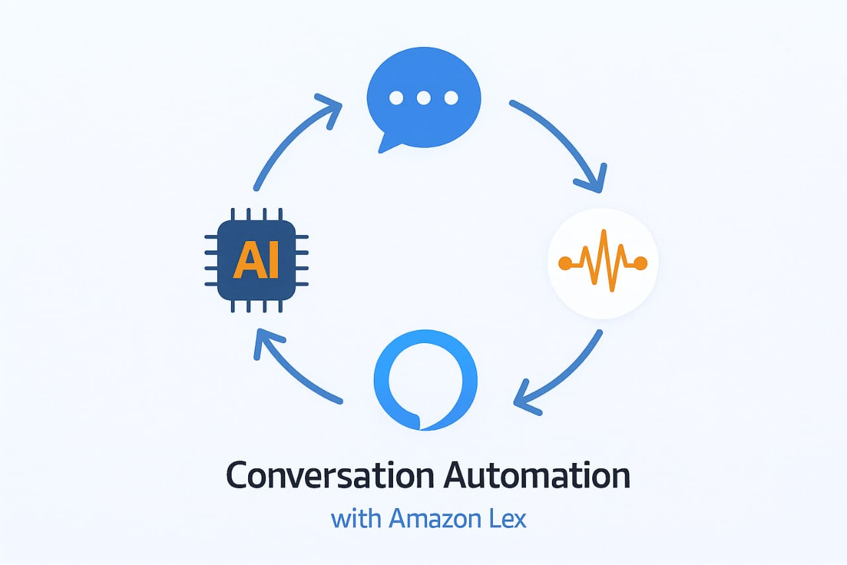

Slide 8
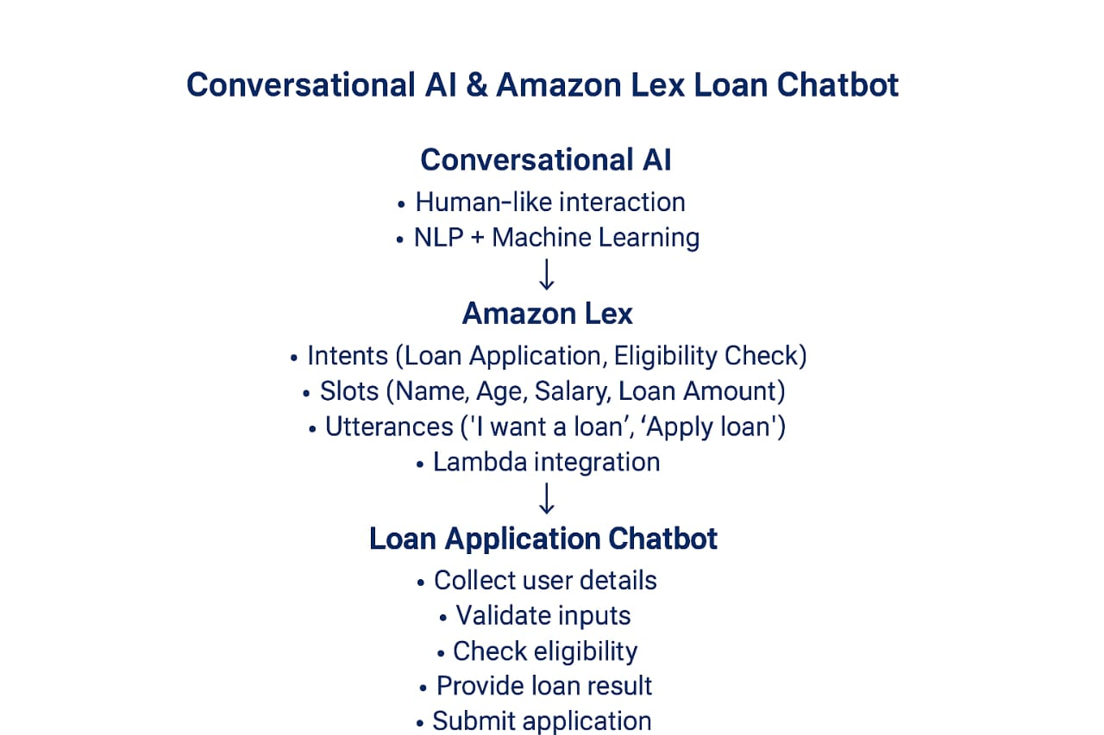

Slide 9
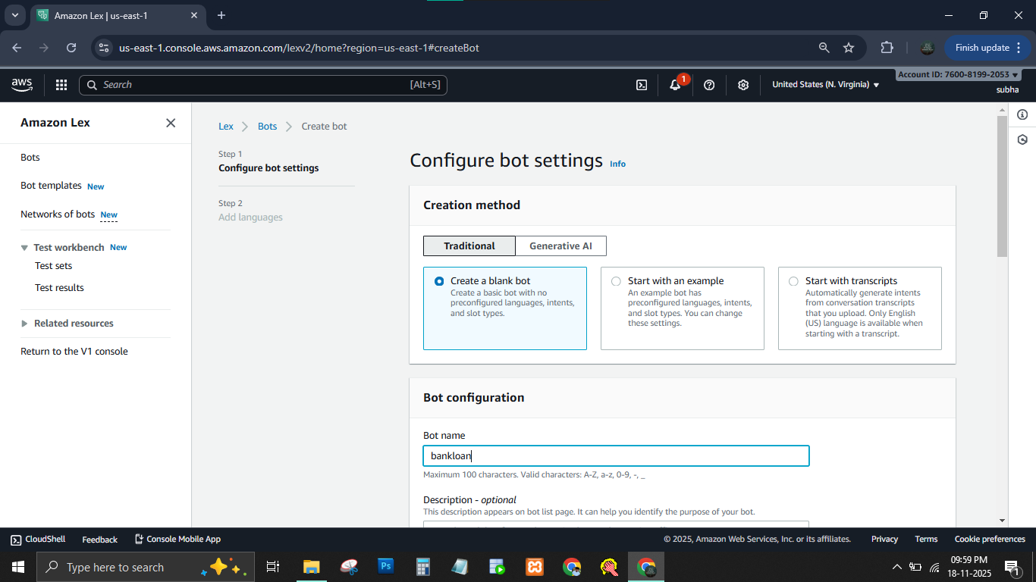

Slide 10
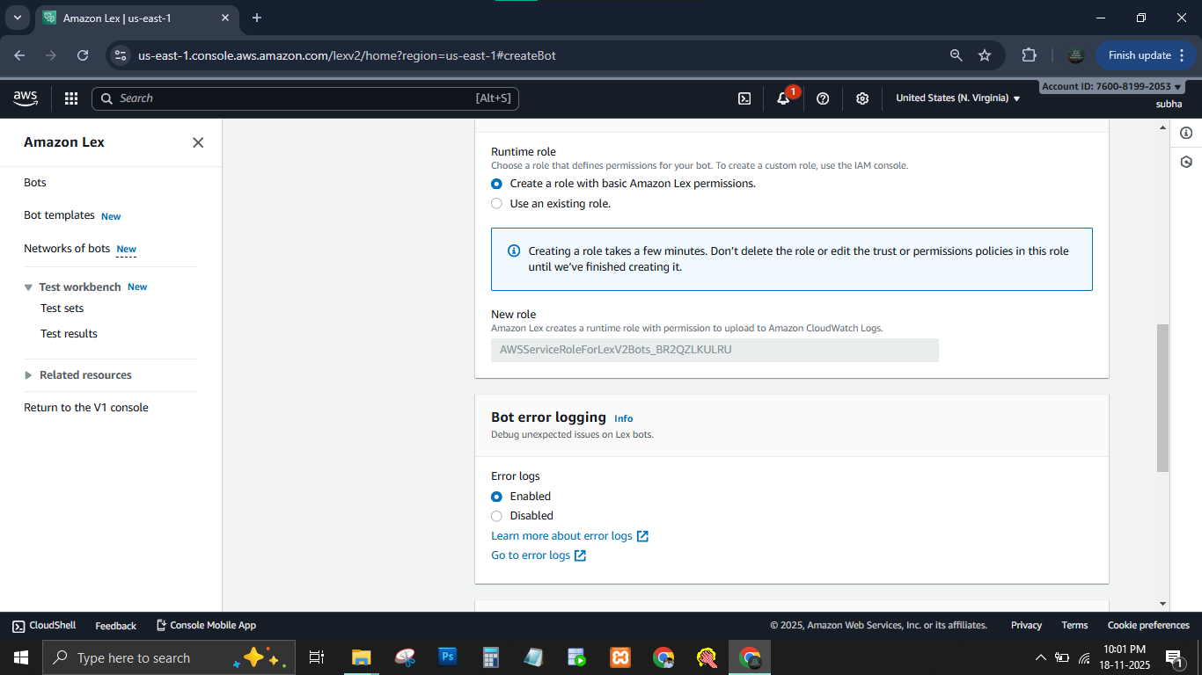

Slide 11
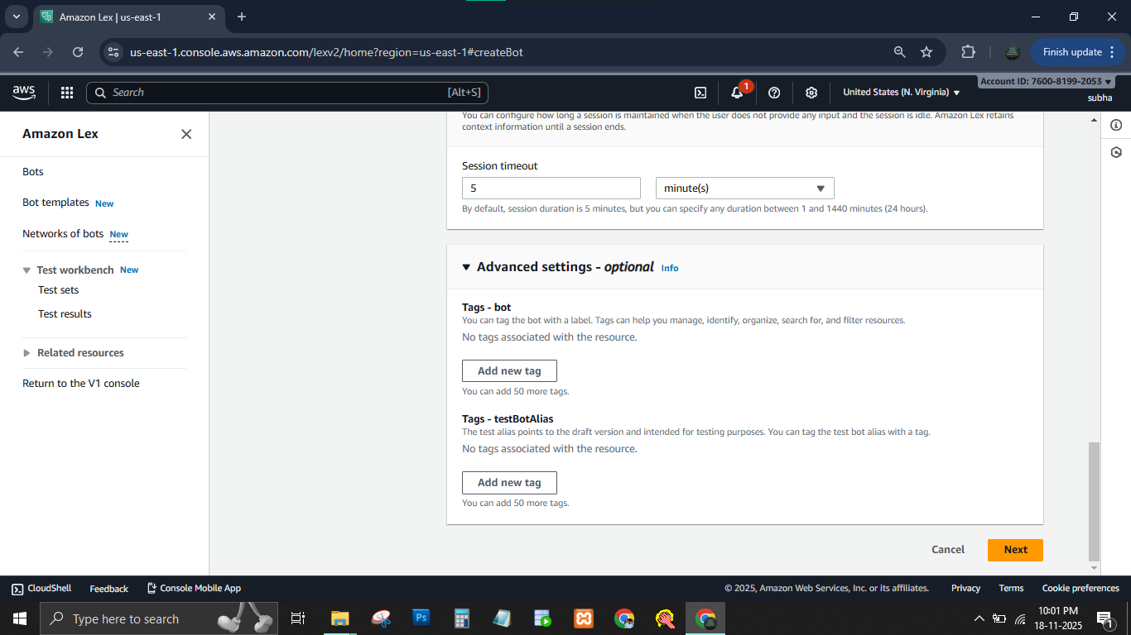

Slide 12
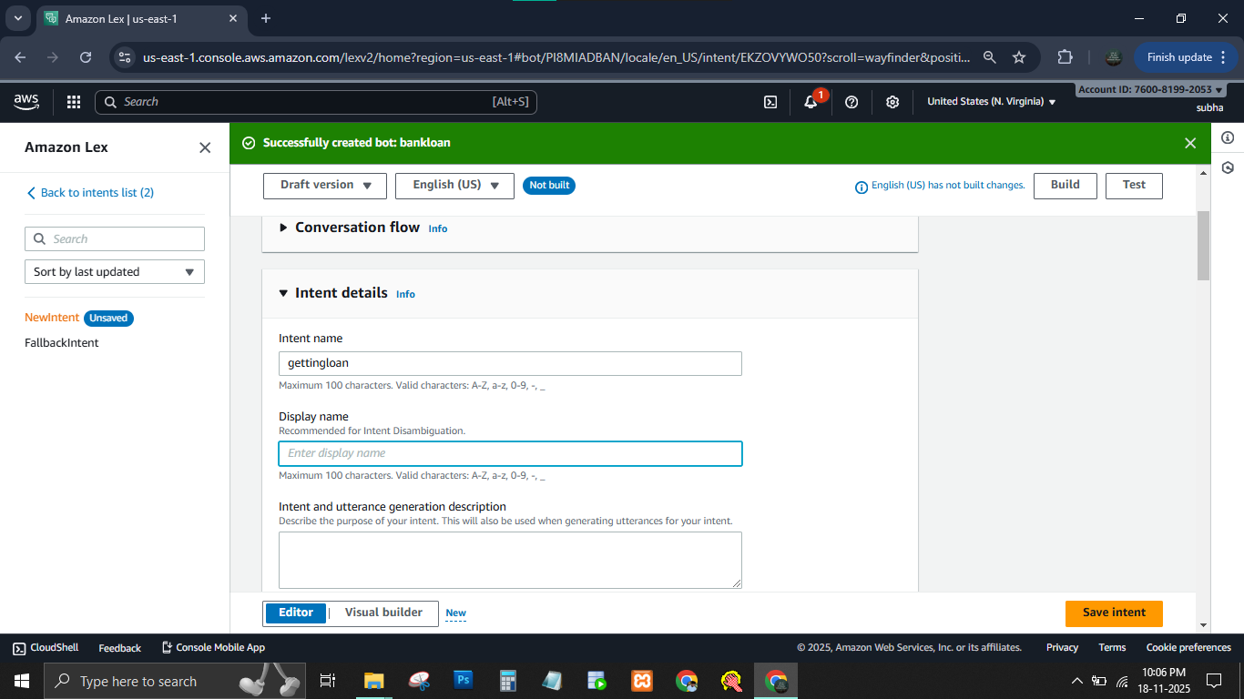

Slide 13
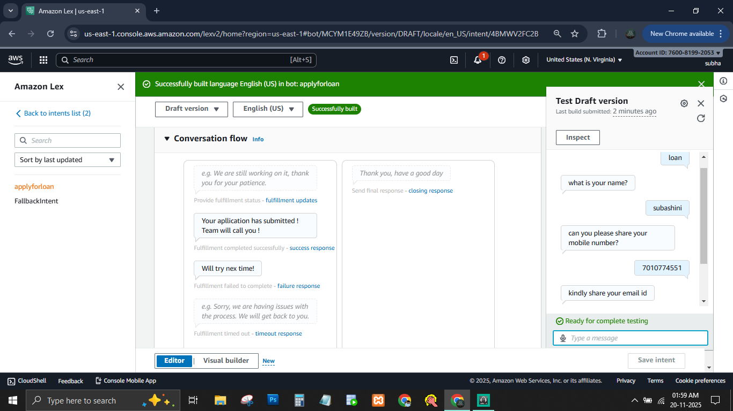

Slide 14
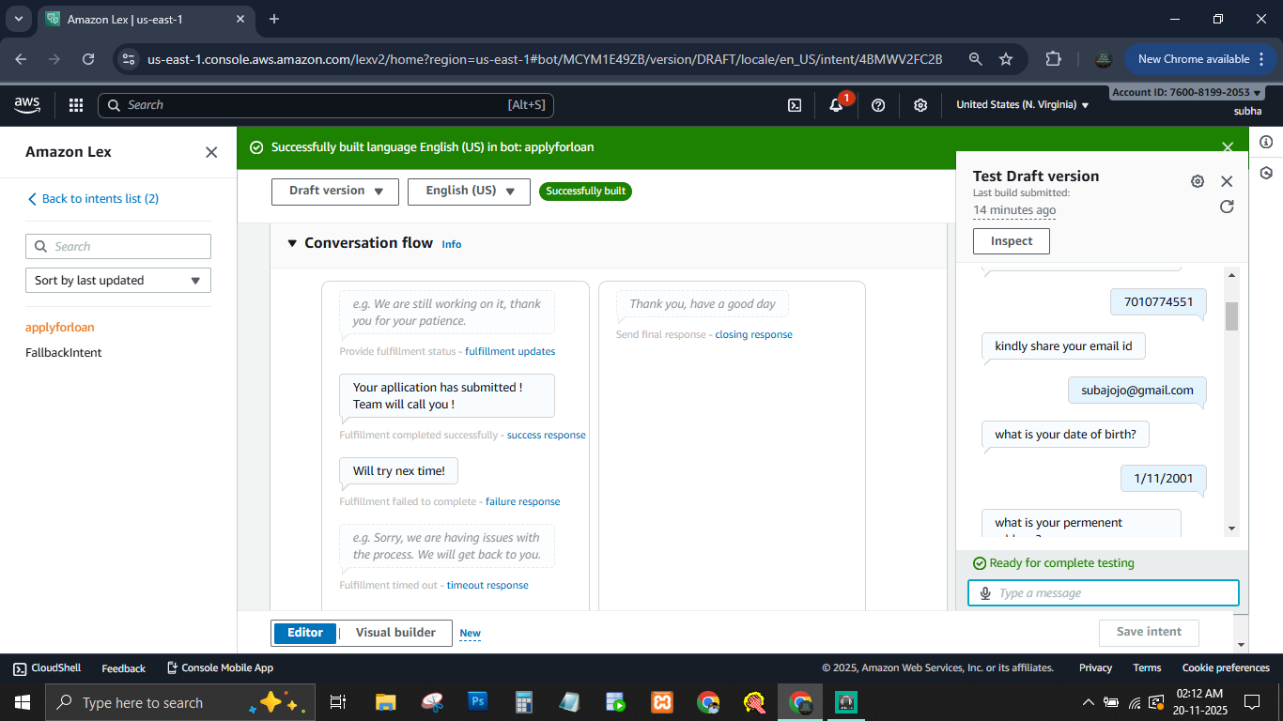

Slide 15
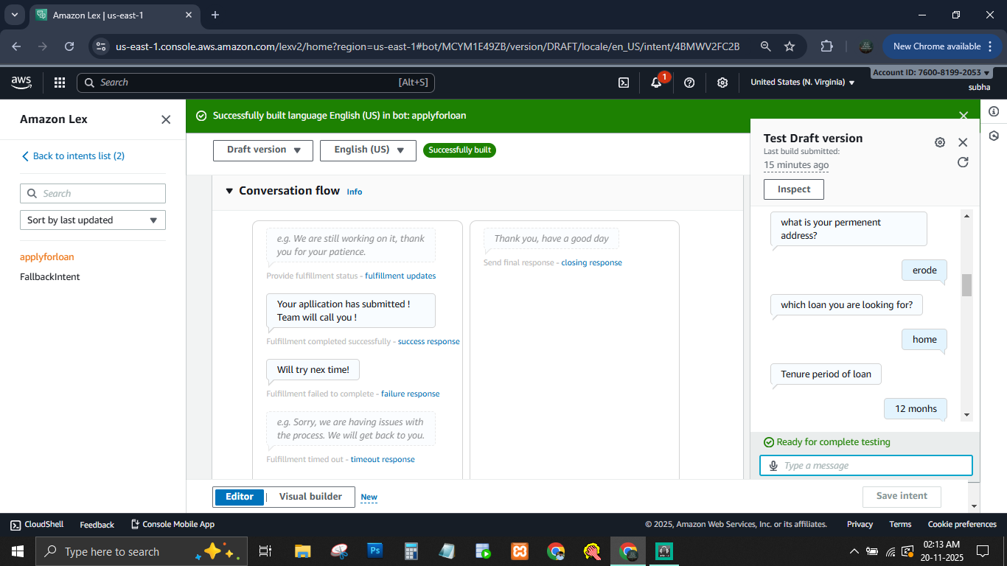

Slide 16
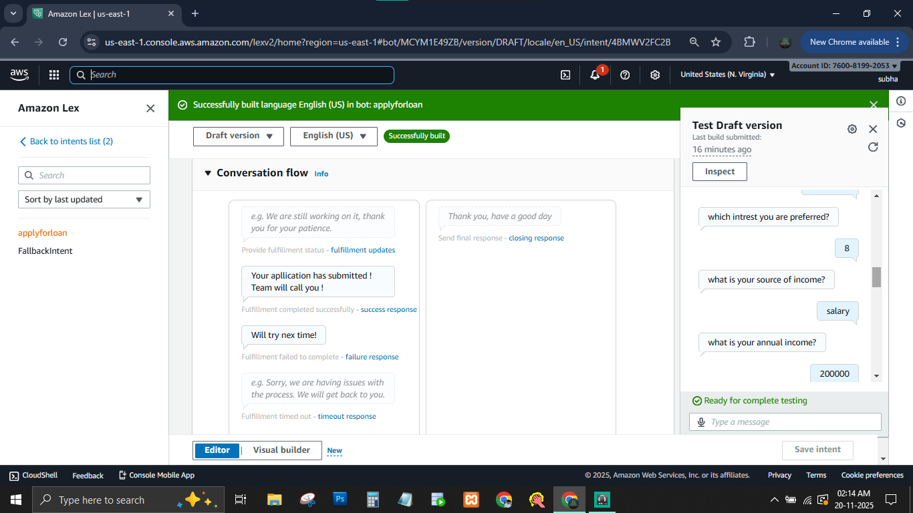

Slide 17
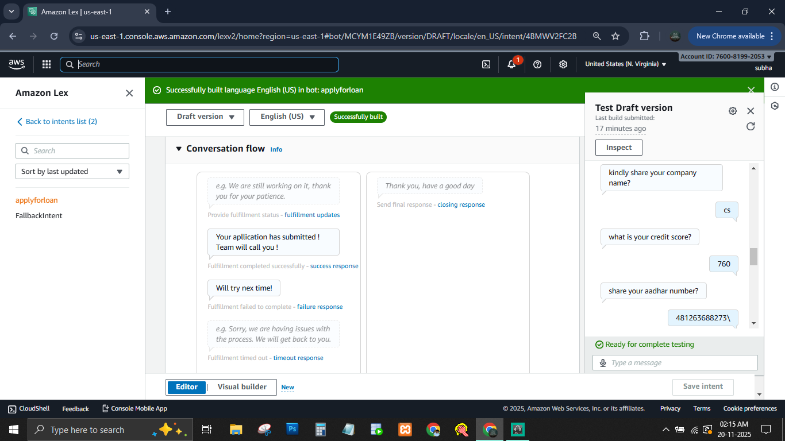

Slide 18
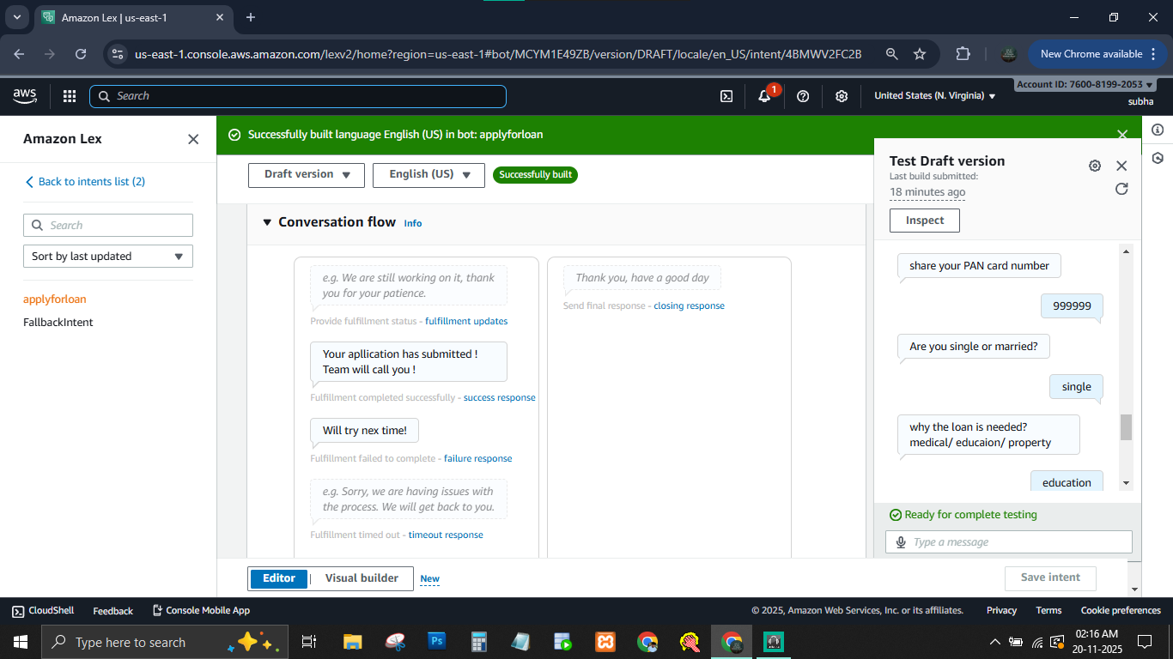

Slide 19
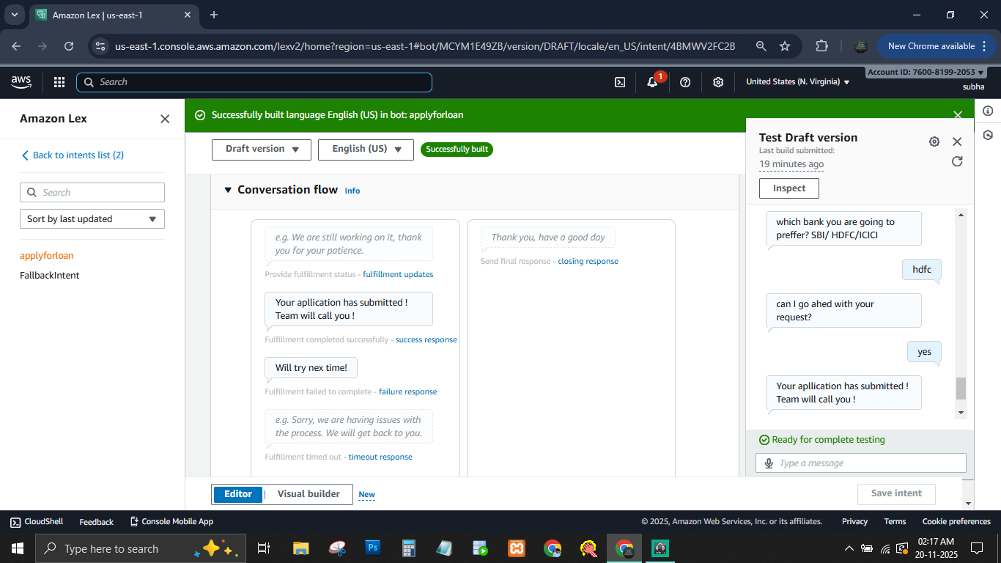

Slide 20
THANK YOU

